Slide 1

Color Conversion Toolbox with Color Vision Deficiency Simulation
Xingzhou Tu
OPTI588 couse project

Slide 2
Outline
Color space conversion
Spectrum conversion
Simulation for color vision deficiency

Slide 3
Functions of the toolbox
Perform conversion between various color space.
XYZ, xyY, Luv, Lab, sRGB, AdobeRGB.
Custom defined RGB with Red, Green, Blue, White primaries provided.
Given a spectrum distribution, it can compute its XYZ tristimulus.
Display a color with XYZ given on the monitor using sRGB color space.
Provide vision simulation of person with color vision deficiency.
Protanopia, Deuteranopia, Tritanopia.

Slide 4
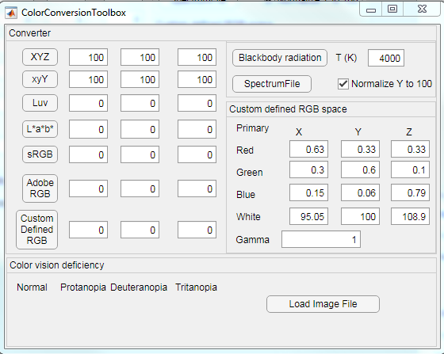
GUI

Slide 5
Color space conversion
Equations, Algorithms provided in lecture notes.
Click the ‘XYZ’ button and the GUI will convert the input XYZ values to other color spaces.
Linear scaling white adaption.

Slide 6
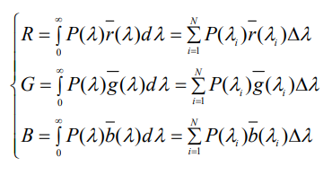
Spectrum conversion
Color matching functions provided in class website.
Integration to compute XYZ values
Blackbody spectrum provided.
Spectrum file in csv or xls.
First column: wavelength
Second column: Intensity

Slide 7
Color vision deficiency simulation
Brettel model
H. Brettel, F. Vienot, and J. D. Mollon. Computerized simulation of color ´ appearance for dichromats. J. Opt. Soc. Am., 14(10):2647–2655, 1997.
Simulation for Dichromacy:
Protanopia (L cone absent)
Deuternapia (M cone absent)
Tritanopia (S cone absent)

Slide 8
Brettel model
Assumption:
Some hues appear the same to dichromatic and to normal observers.
Protanopic: 575nm 475nm
Deuteranopic: 575nm 475nm
Tritanopic: 660nm 485nm
At these specific wavelength, the dichromats should have the same L M S cone response as normal observers.
Neutral color (Grey) for normal observers are perceived as neutrals for dichromats.

Slide 9
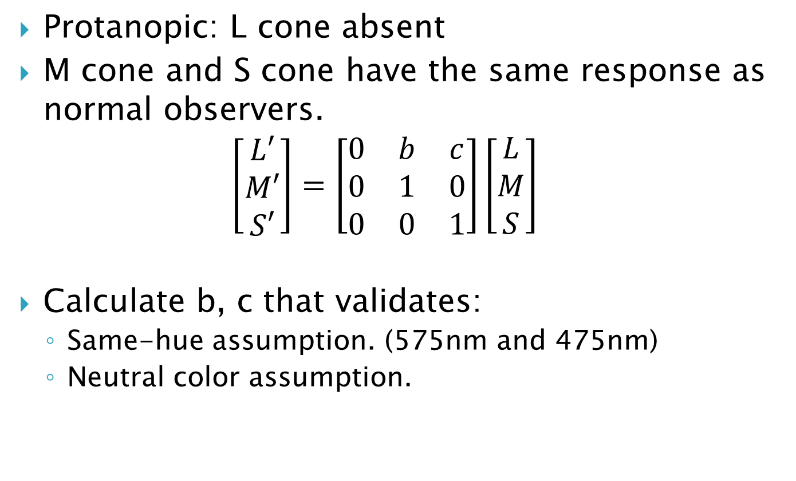
Example: Protanopic
Protanopic: L cone absent
M cone and S cone have the same response as normal observers.
$$\left[\begin{matrix}L′ \\ M′ \\ S′\end{matrix}\right]=\left[\begin{matrix}0 & b & c \\ 0 & 1 & 0 \\ 0 & 0 & 1\end{matrix}\right]\left[\begin{matrix}L \\ M \\ S\end{matrix}\right]$$
Calculate b, c that validates:
Same-hue assumption. (575nm and 475nm)
Neutral color assumption.

Slide 10
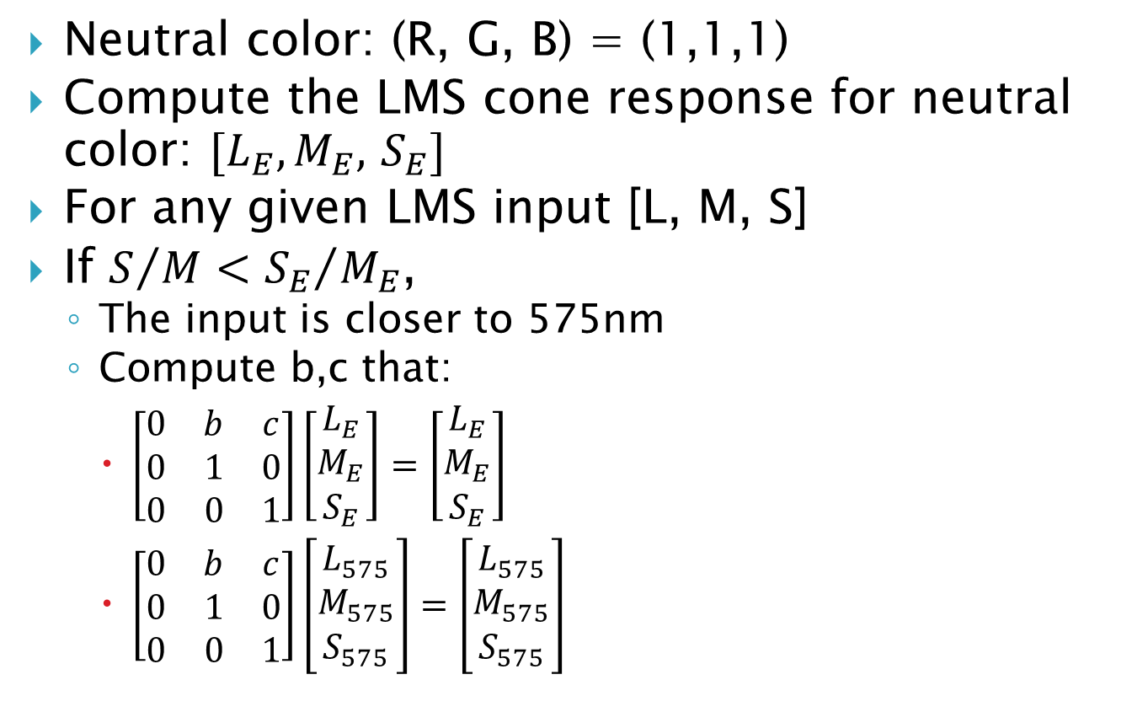
Example: Protanopic
Neutral color: (R, G, B) = (1,1,1)
Compute the LMS cone response for neutral color: ${[L}_{E},M_{E},$ $S_{E}]$
For any given LMS input [L, M, S]
If $S/M<{S_{E}}/{M_{E}}$,
The input is closer to 575nm
Compute b,c that:
$\left[\begin{matrix}0 & b & c \\ 0 & 1 & 0 \\ 0 & 0 & 1\end{matrix}\right]\left[\begin{matrix}L_{E} \\ M_{E} \\ S_{E}\end{matrix}\right]=\left[\begin{matrix}L_{E} \\ M_{E} \\ S_{E}\end{matrix}\right]$
$\left[\begin{matrix}0 & b & c \\ 0 & 1 & 0 \\ 0 & 0 & 1\end{matrix}\right]\left[\begin{matrix}L_{575} \\ M_{575} \\ S_{575}\end{matrix}\right]=\left[\begin{matrix}L_{575} \\ M_{575} \\ S_{575}\end{matrix}\right]$

Slide 11
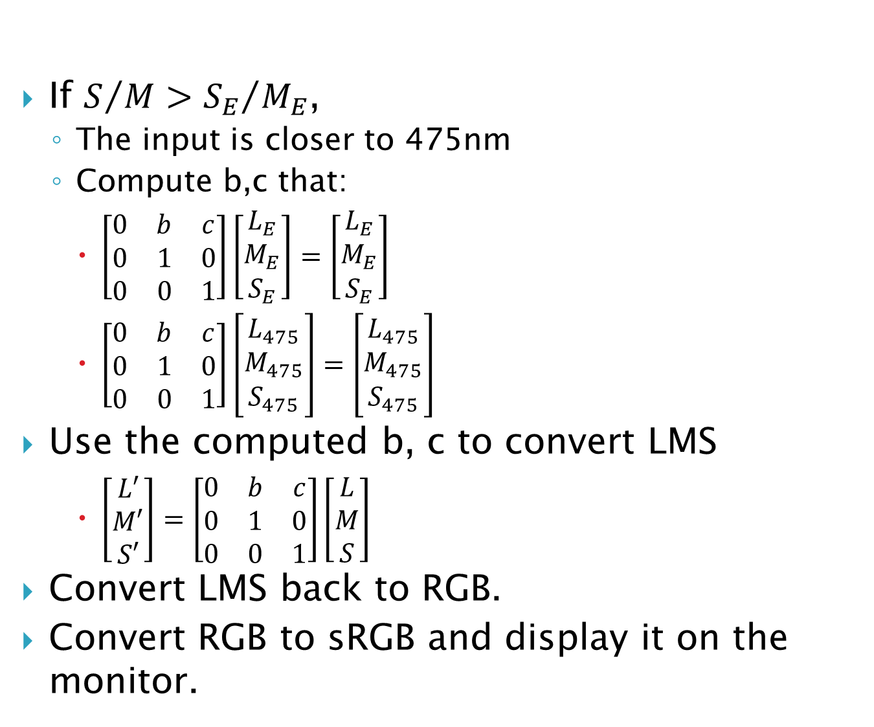
If $S/M>{S_{E}}/{M_{E}}$,
The input is closer to 475nm
Compute b,c that:
$\left[\begin{matrix}0 & b & c \\ 0 & 1 & 0 \\ 0 & 0 & 1\end{matrix}\right]\left[\begin{matrix}L_{E} \\ M_{E} \\ S_{E}\end{matrix}\right]=\left[\begin{matrix}L_{E} \\ M_{E} \\ S_{E}\end{matrix}\right]$
$\left[\begin{matrix}0 & b & c \\ 0 & 1 & 0 \\ 0 & 0 & 1\end{matrix}\right]\left[\begin{matrix}L_{475} \\ M_{475} \\ S_{475}\end{matrix}\right]=\left[\begin{matrix}L_{475} \\ M_{475} \\ S_{475}\end{matrix}\right]$
Use the computed b, c to convert LMS
$\left[\begin{matrix}L′ \\ M′ \\ S′\end{matrix}\right]=\left[\begin{matrix}0 & b & c \\ 0 & 1 & 0 \\ 0 & 0 & 1\end{matrix}\right]\left[\begin{matrix}L \\ M \\ S\end{matrix}\right]$
Convert LMS back to RGB.
Convert RGB to sRGB and display it on the monitor.

Slide 12
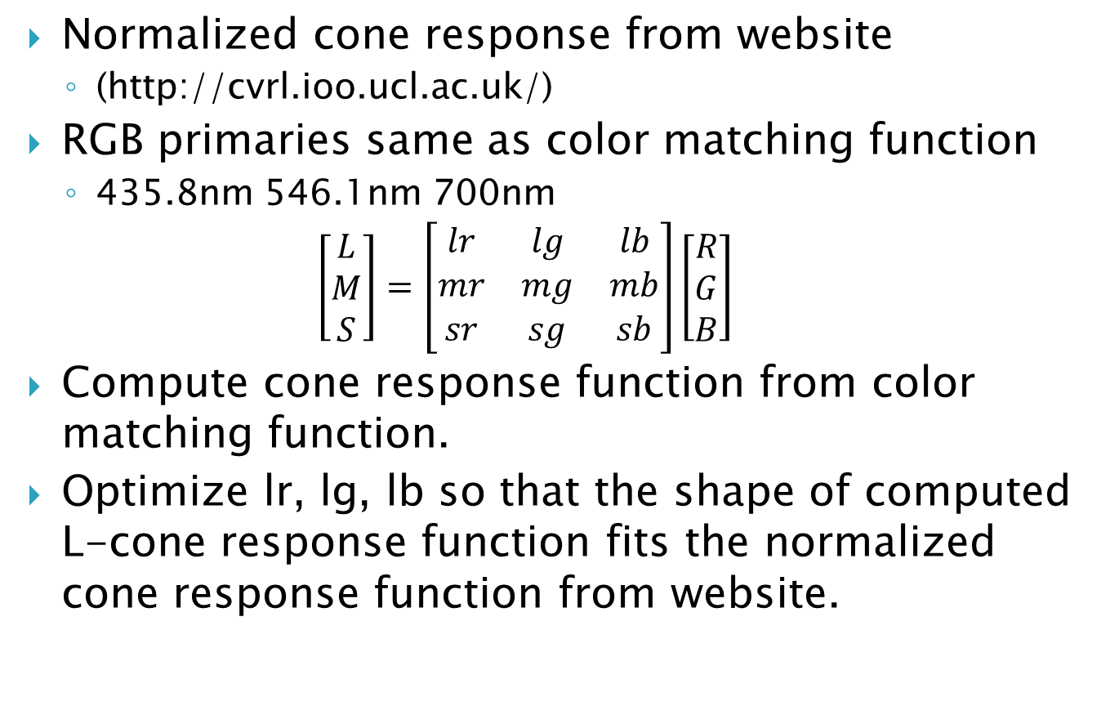
RGB to LMS conversion
Normalized cone response from website
(http://cvrl.ioo.ucl.ac.uk/)
RGB primaries same as color matching function
435.8nm 546.1nm 700nm
$$\left[\begin{matrix}L \\ M \\ S\end{matrix}\right]=\left[\begin{matrix}lr & lg & lb \\ mr & mg & mb \\ sr & sg & sb\end{matrix}\right]\left[\begin{matrix}R \\ G \\ B\end{matrix}\right]$$
Compute cone response function from color matching function.
Optimize lr, lg, lb so that the shape of computed L-cone response function fits the normalized cone response function from website.
Ref: A. Stockman, D. I. A. MacLeod, and N. E. Johnson, ‘‘Spectral sensitivities of the human cones,’’ J. Opt. Soc. Am. A 10, 2491–2521 (1993).

Slide 13
Simulation result
Normal
Protanopia
Deuteranopia
Tritanopia

Slide 14
Simulation result

Slide 15
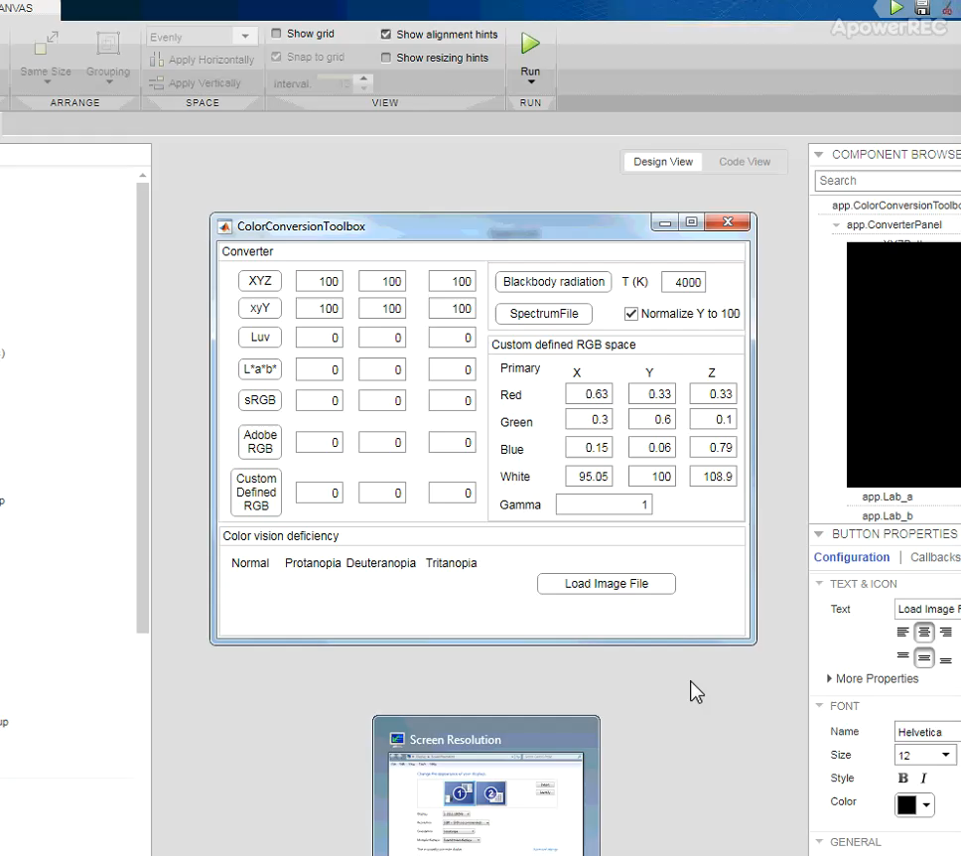

Slide 16
Thanks for your attention!
Reference:
H. Brettel, F. Vienot, and J. D. Mollon. Computerized simulation of color ´ appearance for dichromats. J. Opt. Soc. Am., 14(10):2647–2655, 1997.
A. Stockman, D. I. A. MacLeod, and N. E. Johnson, ‘‘Spectral sensitivities of the human cones,’’ J. Opt. Soc. Am. A 10, 2491–2521 (1993).
OPTI588 Lecture notes.

